Slide 1
Introductions
Mr. Michael Owens – Principal
Mrs. Harley Skinner – Assistant Principal / AD
Mrs. Emily Wells – CCHS Secretary
Mrs. Sharie Ledgerwood – CCHS Treasurer
Mrs. Amber Sinders – CCS Coordinator of Nursing / CCHS Nurse
Mrs. Jennifer Gerber – School Counselor
Mrs. Deanne Blankenship – School Counselor
Mrs. Michelle Weber – Guidance Secretary
Mr. Matt Weber - SRO

Slide 2
CCHS Daily Schedule
8:15 - 9:02 Period 1
9:07 – 9:54 Period 2
9:59 - 10:46 Period 3
10:51 – 11:17 Eel Time
11:17 - 11:47 Lunch grades 10 - 12
11:22 - 12:09 Period 4 grades 7 - 9
12:09 - 12:39 Lunch grades 7 - 9
11:52 - 12:39 Period 4 grades 10 - 12
12:44 - 1:31 Period 5
1:36 - 2:23 Period 6
2:28 - 3:15 Period 7

Slide 3
Class of 2029 Diplomas
The structure of The New Diploma is a base diploma that everyone will need to earn. Optional honors seals may be added to the base diploma. Honors seals are earned through specific coursework, academic performance, work based learning, and attendance. Differing seals have differing requirements.
New Indiana Diploma
Indiana Honors Seals (optional)
Indiana Honors Plus Seals (optional)

Slide 4
The following chart shows current and new diploma language. It is important to note that both sets of describers will be used for the next three years until the class of 2028 graduates. Though current and new language have similar context, their meanings are different. For example, the current Technical
Honors is not the same as the Employment Honors Seal
Current "Old" Language (Ending with class of 2028) | New Language (Starting with class of 2029)
Core 40 Diploma | New Indiana Diploma
Academic Honors Diploma | Enrollment Honors Seal
Technical Honors Diploma | Enrollment Honors Plus Seal
 | Employment Honors Seal
 | Employment Honors Plus Seal
 | Enlistment & Service Seal
 | Enlistment & Service Plus Seal

Slide 6

IN New Diploma (Pathway)
43 Credits (42 Indiana required courses + 1 Clay Community Schools requirement)

Slide 8
A readiness seal is not required for graduation. However, if a student does not earn a readiness seal, they will need to complete a graduation pathway, demonstrate employability skills, and demonstrate post-secondary readiness, something all graduates currently must accomplish.
Here are examples of diploma/seal combinations:
Student A: New Indiana Diploma with a required graduation pathway, employability skills, and post-secondary readiness
Student B: New Indiana Diploma with an Enrollment Honors Seal
Student C: New Indiana Diploma with an Employment Honors Plus Seal
Student D: New Indiana Diploma with an Enlistment and Service Honors Plus Seal and an Employment Honors Seal
As you can see, students must earn the New Indiana Diploma. Readiness seals on the other hand, are not required but additions recognizing further achievement. Also, the seals are not exclusive of each other and may be earned in combination.
Again, if a student does not earn an honors seal, they must achieve a graduation pathway, demonstrate employability skills, and demonstrate post-secondary readiness. Students who earn an honors seal, do not have to meet these requirements.

Slide 9
IN Honors Seal Diploma
43 Credits (42 Indiana required courses + 1 Clay Community Schools requirement)
Honors Seals (may earn one or multiple seals)

Slide 10
Choosing a Readiness Seal
Which path do you want to take?
            Enrollment (college)
            Employment (workforce)
            Enlistment (military)
The expectation is for every student to complete a seal, satisfying all graduation requirements.
Students MUST complete a seal in order to be eligible for early graduation.
Students can complete multiple seals.

Slide 11
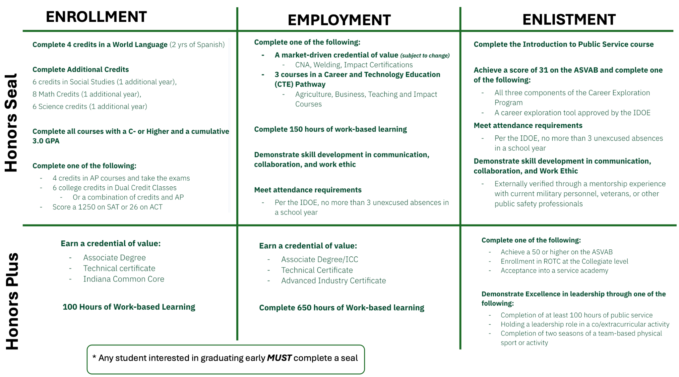

Slide 12
Complete 4 credits in a World Language (2 years of Spanish)
Complete Additional Credits
6 credits in Social Studies
8 Math Credits (Algebra I, Geometry, Algebra II, and Pre-Cal or any
advanced math)
6 Science credits (must include Biology 1 and Chemistry)
Complete all courses with a C or Higher and a cumulative 3.0 GPA
Complete one of the following:
4 credits in AP courses AND take the exams
6 college credits in Dual Credit Classes
  Or 3 college credits and 2 AP credits AND exams
Score a 1250 on SAT or 26 on ACT
Enrollment
Seal
Enrollment
Honors

Slide 15

Complete one of the following:
A market-driven credential of value (CNA, Welding, etc)
3 courses in a Career and Technology Education (CTE) Pathway
  Agriculture, Automotive, Business, Construction, Cosmetology, Culinary, Education, Engineering, Law/Public Safety, Pre-Nursing (CNA), Welding
Complete 150 hours of work-based learning
Demonstrate skill development in communication, collaboration, and work ethic
Meet attendance requirements
Per the IDOE, no more than 3 unexcused absences in a school year
Employment
Honors

Slide 17
Complete Introduction to Public Service course or one year of JROTC in high school
Achieve a score of 31 on the ASVAB and complete one of the following:
All three components of the Career Exploration Program
A career exploration tool approved by the IDOE
Meet attendance requirements
Per the IDOE, no more than 3 unexcused absences in a school year
Demonstrate skill development in communication, collaboration, and Work Ethic
Externally verified through a mentorship experience with current military personnel, veterans, or other public safety professionals
Enlistment
Seal
Enlistment
Honors

Slide 19
Honors Plus Seals
Enlistment
Honors
Plus
Enrollment Plus
Employment Plus
Enlistment Plus
Complete one of the following:
Achieve a 50 or higher on the ASVAB
Enrollment in ROTC at the Collegiate level
Acceptance into a service academy
Demonstrate Excellence in leadership through one of the following:
Completion of at least 100 hours of public service
Holding a leadership role in a co/extracurricular activity
Completion of two seasons of a team-based physical sport or activity
Earn a credential of value:
Associate Degree
Technical certificate
Indiana Common Core
100 Hours of Work-based Learning
Earn a credential of value:
Associate Degree/ICC
Technical Certificate
Advanced Industry Certificate
Complete a total of 650 hours of Work-based learning
Enrollment
Honors
Plus
EmploymentHonors
Plus

Slide 23
Once again, a readiness seal is not required for graduation. However, if a student does not earn a readiness seal, they will need to complete a graduation pathway, demonstrate employability skills, and demonstrate post-secondary readiness, something all graduates currently must accomplish.
All students must earn the New Indiana Diploma.
Readiness seals on the other hand, are not required but additions recognizing further achievement. Also, the seals are not exclusive of each other and may be earned in combination.
Again, if a student does not earn an honors seal, they must achieve a graduation pathway, demonstrate employability skills, and demonstrate post-secondary readiness. Students who earn an honors seal, do not have to meet these requirements.

Slide 24
Honors Seals vs Honors Plus Seals
The honors seals are similar to a traditional academic honors diploma, focusing on strong academic performance in core classes.
The honors plus seals are designed to increase skill development, work-based learning experiences, as well as opportunities for students to earn a credential of value. Requires students to go above and beyond the standard honors requirements by completing additional activities like internships or certifications often with a focus on career readiness.
Students who earn a readiness seal will automatically fulfill all Graduation Pathways requirements. Students who do not earn a seal must still complete components 2 and 3 of Graduation Pathways.

Slide 25
Traditional High School Pieces that have not changed
Earning credits
Students must pass a course at the end of a semester to earn a credit
Failed courses must be retaken
All Semester grades appear on your transcript which is an official document that is typically required for college and scholarship applications.
Courses are worth one credit per semester. Students can earn up to 14 credits per year.
High School Testing
ILEARN Biology (Taken in the spring of the year they finish the Biology course)
PSAT (10th grade year)
SAT (11th grade year)
Naturalization Exam (12th grade year)
ASVAB (Students interested in an enlistment seal)
AP Exams(Taken after the completion of an AP course)
Grade Point Average (4.0 scale)
Career Discovery Meetings (CDMs) Grades 11, 12…30 minute meetings with an approved postsecondary educational institution, employer, or labor organization to discuss future career opportunities (on school grounds).

Slide 26
Sample 4-year Plans
Enrollment
Enlistment and Employment
9th | 10th | 11th | 12th
English 9 | Eng 10 / Speech | English 11 | English 12
Algebra I or Geometry | Geometry or Algebra II | Algebra II or Pre-Cal | Pre-Cal or any other math
Biology | Chemistry or Physics | STEM | Gov / Econ
Health / PE | World History | US History | Seal Focused
Spanish I | Spanish II | Comp Sc / Pers. Finance | Seal Focused
Seal Focused | Seal Focused | Seal Focused | Personalized Electives
Personalized Electives / PCC | Personalized Electives | Personalized Electives | Personalized Electives
9th | 10th | 11th | 12th
English 9 | English 10 / Speech | English 11 | English 12
Algebra I | Geometry | Algebra II | Gov / Econ
Biology | Chemistry or Physics | STEM | Seal Focused
Health / PE | World History | US History | Seal Focused
PCC / | Seal Focused | Comp Sc / Pers Finance | Personalized Electives
Personalized Electives | Personalized Electives | Seal Focused | Personalized Electives
Personalized Electives | Personalized Electives | Personalized Electives | Personalized Electives

Slide 27
Personalized Electives
CTE Pathways
(Principles course required in 9th grade unless 1)earning a seal, 2) taking three college courses in high school)
Agriculture – Plants/Animals
Agriculture – Mechanical/Engineering
Business – Business Administration
Business – Marketing/Sales
Education Professions (@NHS)
Engineering
FACS – Culinary Arts
Law, Public Safety, Corrections, Security (@NHS)
Vocational:
Automotive (@NHS)
Construction (@NHS)
Welding (@NHS)
Cosmetology (Linton Beauty College)
Pre – Nursing (@NHS)
Agriculture
Art – ex: ceramics, fibers, 2-D, 3-D
Business
Engineering Technology
English – ex: Speech, Etymology, Yearbook, Theatre
Family and Consumer Science – ex: Nutrition, PCC, Child Dev
Health / PE
Math
Music – ex: Band
Science
Social Studies - ex: Psychology, Sociology, Current Events, Film
Internships
World Languages – Spanish
(complete list sent to student Outlook account)

Slide 28
21st Century Scholars
Eligibility determined by family income
Scholarship covers up to four years of college tuition at any public college/university in Indiana
  Scholarship covers a portion of tuition at private institutions
Students enrolled in the free/reduced lunch program will be automatically enrolled
  Parents will receive a letter regarding enrollment status
Students not enrolled in the free/reduced lunch program may still qualify for 21st Century Scholars
  Submit a paper application or apply online by end of 8th grade

Slide 29


QUESTIONS

